Slide 1


Database Management System
TRANSACTION MANAGEMENT
CONCURRENCY CONTROL AND RECOVERY MECHANISMS
Presented to -
Mohammad Jahangir Alam
Assistant Professor,
Department of Computer Science and Engineering
Faculty of Science and Information Technology
Daffodil International University

Slide 2
Our Team
[In order of appearance]
Nur Sayda [232-15-437]
Samira Haque Vabna [232-15-764]
Supan Roy [232-15-716]
Abdullah Al Noman [232-15-797]
Shakira Rahman Simi [232-15-723]
Group 7
1

Slide 3
Table Of Contents
What is a Transaction?
Recovery Mechanisms
ACID Properties
Transaction States
Concurrent Transactions
Best Practices in DBMS
Concurrency Control
Group 7
2

Slide 4

What is a Transaction?
A transaction is a logical unit of work in a database.
It consists of one or more operations (like reading, writing, updating data).
A transaction must be completed fully or not at all.
Ensures data accuracy and integrity.
Example: Transferring ৳1000 from Account A to B:
Deduct ৳1000 from A
Add ৳1000 to B
(Both steps must succeed together)
[232-15-437]
3

Slide 5
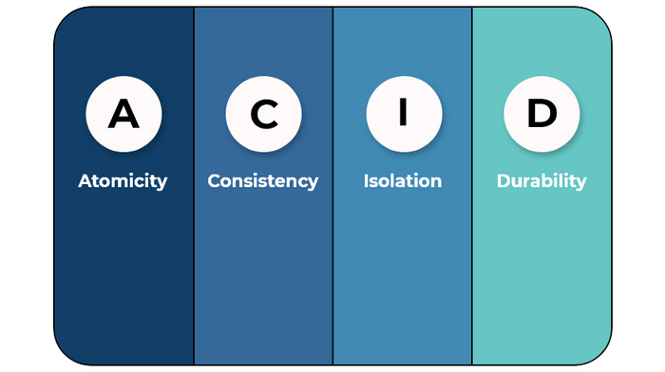
ACID Properties of Transactions
Atomicity: All operations of a transaction are completed, or none at all.
Consistency: Ensures the database moves from one valid state to another.
Isolation: Transactions are independent and do not interfere with each other.
Durability: Once a transaction is committed, changes are permanent—even after a crash.
[232-15-437]
4

Slide 6
The Problem – Concurrent Transactions
In real systems, multiple transactions run at the same time. This can lead to conflicts and inconsistencies in the database. Concurrency control is needed to manage this.
Common Problems from Concurrency
Dirty Read Problem
Unrepeatable Read Problem
Phantom Read Problem
Lost Update Problem
[232-15-764]
5

Slide 7

Concurrency Control – What & Why?
Concurrency control manages multiple transactions executing at the same time.
It ensures correctness, consistency, and isolation.
Techniques Used:
Lock-Based Protocols
Timestamp Ordering
Optimistic Concurrency Control
[232-15-764]
6

Slide 8
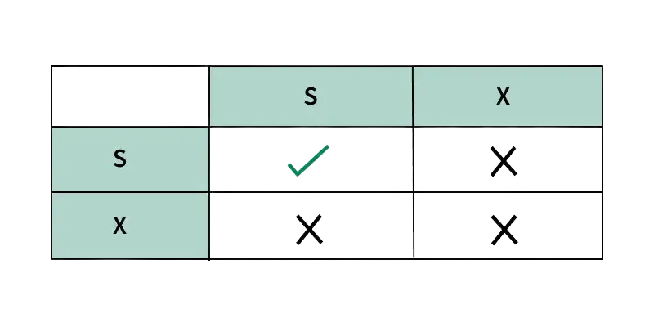
1.Lock-Based Concurrency Control
Uses locks to control access to data items.
Prevents multiple transactions from accessing the same data at the same time.
Types of Locks:
Shared Lock (S): Allows multiple transactions to read.
Exclusive Lock (X): Only one transaction can write (no one else can read or write).
[232-15-716]
7

Slide 9
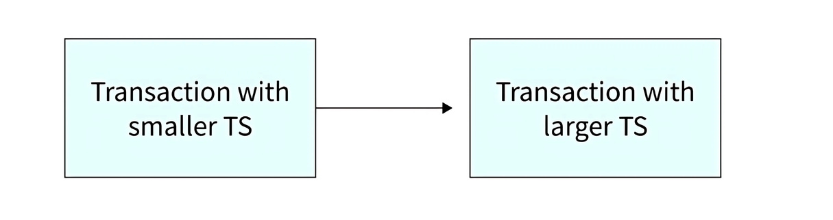
2.Timestamp Ordering Protocol
Every transaction is given a unique timestamp when it starts.
Prevents conflicts without using locks.
For example:
If Transaction T1 enters the system first, it gets a timestamp TS(T1) = 007 (assumption).
If Transaction T2 enters after T1, it gets a timestamp TS(T2) = 009 (assumption).
[232-15-716]
8

Slide 10
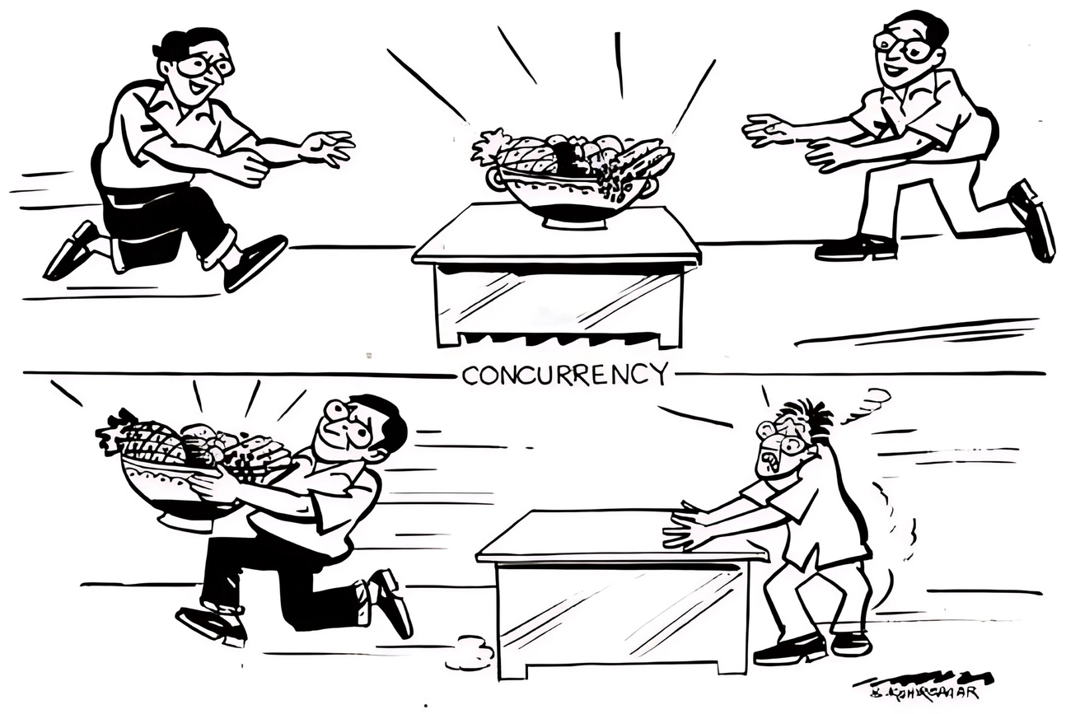


3.Optimistic Concurrency Control
Assumes conflicts are rare — so no locks used initially.
Transactions proceed without restrictions.
At commit time, system checks for conflicts:
If no conflict → transaction is committed.
If conflict detected → transaction is rolled back.
[232-15-716]
9
Image credit:

Slide 11
What Happens if Something Fails?
Transactions may fail due to:
System crashes
Power failures
Application or logic errors
These failures can leave the database in an inconsistent state.
We need recovery mechanisms to:
Undo uncommitted changes
Redo committed changes
Restore database consistency
[232-15-716]
10

Slide 12
Recovery Mechanisms: Log-Based Recovery
The log is a file that records every database operation performed by a transaction.
Stored on disk, not in memory → survives crashes.
Every log entry includes:
Transaction ID
Operation (e.g., write)
Data item affected
Old and new values
[232-15-797]
11

Slide 13
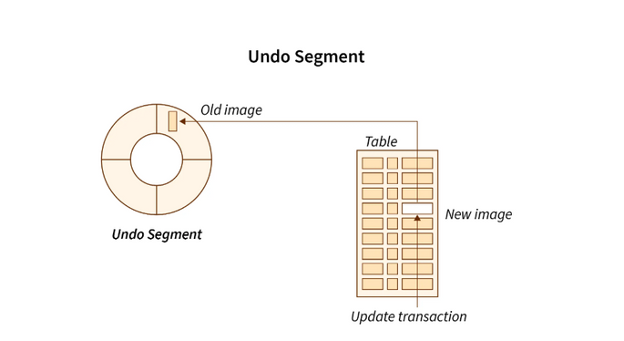
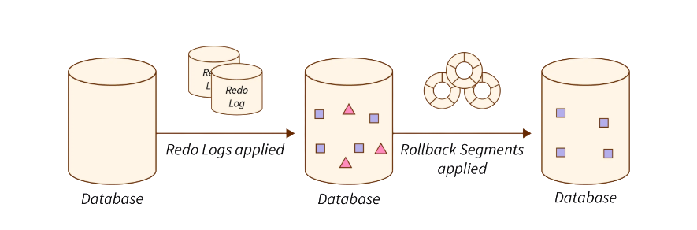

Recovery Mechanisms: Log-Based Recovery
1. Undo(Ti): Restores the old values of each of the items in Ti that have been updated by the transaction Ti.
2. Redo(Ti): Updates all data items updated by transaction Ti with their new values. Undoing a T requires the log to contain both the record <start> and the record <commit>.
[232-15-797]
12
Image credit:

Slide 14
Recovery Mechanisms: Checkpoints
A checkpoint is a snapshot of the database state at a particular time.
It’s written to disk periodically by the DBMS.
<Checkpoint>
<Failure>
<Transaction1>
<Transaction2>
<Transaction3>
<Transaction4>
<Time>
[232-15-797]
13

Slide 15
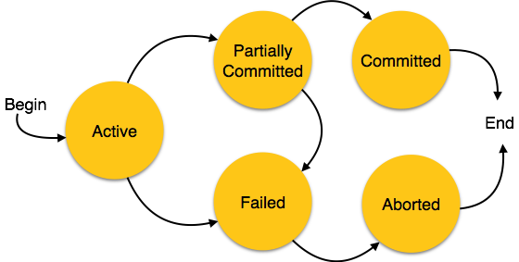

Transaction States
A transaction goes through the following states:
Active – Transaction is running.
Partially Committed – Final operation executed, but not yet saved to disk.
Committed – All changes are saved permanently.
Failed – Some error occurred during execution.
Aborted – Changes are rolled back (undone).
[232-15-723]
14
Image credit:

Slide 16
Best Practices in Transaction Management
Always design transactions to be short and atomic.
Use proper isolation levels to balance concurrency and consistency.
Ensure logs and checkpoints are regularly maintained for recovery.
Understand when to use locking vs optimistic methods.
Monitor transaction failures to improve system reliability.
[232-15-723]
15

Slide 17
THANK YOU
If you have any questions, feel free to ask now

